Slide 1
Managing Your Engineering Career
Achieving Effectiveness as an Engineer

Slide 2
With the expansion of global economies, companies require diverse intellectual capital that can bring ideas and knowledge to the workplace to improve their competitive advantage.
These evolving trends in industry must be applied back into the engineering curriculum. Industry needs universities to respond with the following changes:
Retain strengths in math and physics fundamentals, plus enhanced information technology emphasis.
Increase emphasis on design and manufacturing skills.
New emphasis on breadth, context, and process related issues.

Slide 3
Getting Off to Right Start
You
Make your mark in first few years
Go extra mile and meet deadlines
Look for visibility
Learn the corporate culture
Boss
Be careful in selection
Understand the boss
Keep boss informed
Make boss’s job easy

Slide 4
Associates
Don’t invade another division
Make your complaints to the person responsible
Keep old school ties
You are the company’s representative

Slide 5
Charting Your Career
Career Fields
Operational (manufacturing, purchasing, planning, customer service and sales)
Research and Design (R&D for new systems)
Engineering Management (2/3 of engineers in the past have spent about the last 2/3 of their careers in some level of management responsibility)
Entrepreneurial (Form own company; Risk of failure are greater, but so is the potential reward)
Consulting (Designs, advise, solve problems on behalf of other individuals and organizations)

Slide 6
Writing (Writing for technical magazines, journals, technical editor or abstractor; preparing training & maintenance manual, preparing sales literature of technological product)
Academic (High school teaching , teaching pre-engineering subjects in junior colleges; Careers in universities can be taken as combination of teaching, research, consulting and writing)
Other (Something entirely different from engineering field)

Slide 7
Career Stages – Super (1957)
Growth (birth to age14)
first awareness of career decisions
initial development of career aspirations, interest and abilities
Exploration (ages15 to 24)
trying out tentative choices
transition involving training and trial in a beginning job
Establishment (ages 24 to 44)
The first five years: trial period
1 or 2 changes in field
Maintenance (ages 45 to 65)
Hold on to the place achieved
Continues in established pattern
Disengagement
Physical and mental power decline
Less participation then stops

Slide 8
Four Career Stages for Professionals – Dalton and Thompson
Apprentice learns to be an effective subordinate who demonstrates willingness to do routine assignments, yet aggressively searches out new and more challenging tasks. By leaving this field too early, the individual does not learn from the experience of others. . . .
Colleague building a reputation as a technically competent individual... The individual becomes less dependent and starts to contribute personal ideas about what to do in a given situation. Many professionals stay in this stage for the rest of their careers and have a reasonably successful career although their value to the organization dwindles over time. . . .
Mentor individual is able to take increased responsibility for influencing, guiding, directing, and developing other people. . . . The individual in this stage may serve with one or a combination of three roles: an informal mentor, a manager, or the idea person [gatekeeper]. . . . 80 percent of those who make it to this stage were perceived by the organization to be above-average performers.
Sponsor requires that the individual move up from influencing groups of individuals to affecting the direction of the organization or a major segment of it. . . . These people can play one or more of three roles: manager, internal entrepreneur, or idea innovator [the senior professional person in a field].

Slide 9
Communicating Your Ideas
Communication
A process by which information is
exchanged between
individuals through a common
system of symbols, signs or behavior.
Communication is a two-way process which involves:
Listening to others (Receiving) message
Asserting/Expressing (Sending)

Slide 10
Communication is the art of getting your message across effectively through:
Spoken words: first and simplest way
Body language: can make or mar
Written words: reflects importance
Visuals: leaves greatest impacts

Slide 11
Importance of Communication
A survey conducted with 2600 UK employees clearly expressed the view that what was most de-motivating of all was lack of communication from managers, citing issues such as a complete absence of interaction, a general lack of feedback, or meetings taking place behind closed doors.
In the field of engineering, the information output may be specification, design , drawing, technical reports, or oral briefings which requires substantial resources and skill. Unless the information output is properly communicated, the meticulous engineering may be of little utility.

Slide 12
Engineers must perfect their communication skills while they transit to manager for effectiveness.
It is estimated that managers spend 90% of their time in communication
78% of their time: oral communication
(59% in scheduled,10% in unscheduled meetings,6% on telephone,3% on managing by walking around)
22% on their deskwork which consist reading and writing

Slide 13
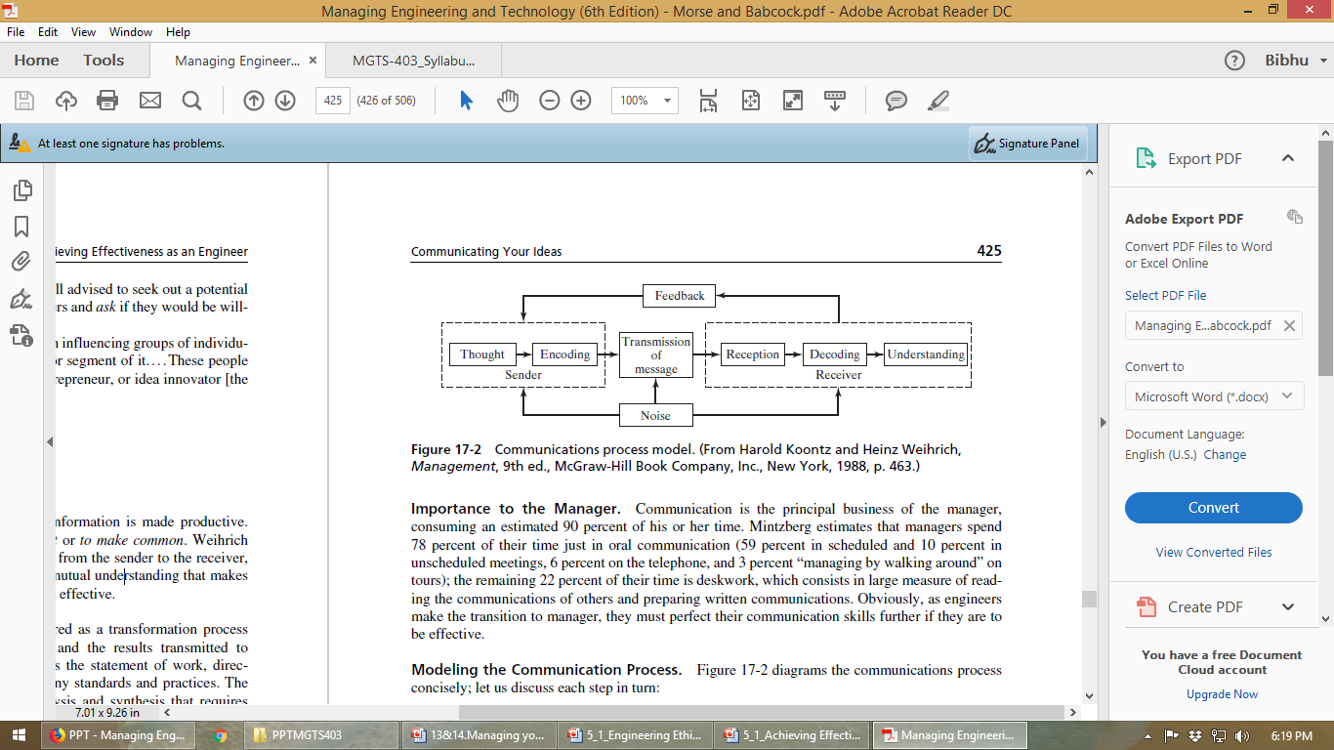
The Communication Process

Slide 14
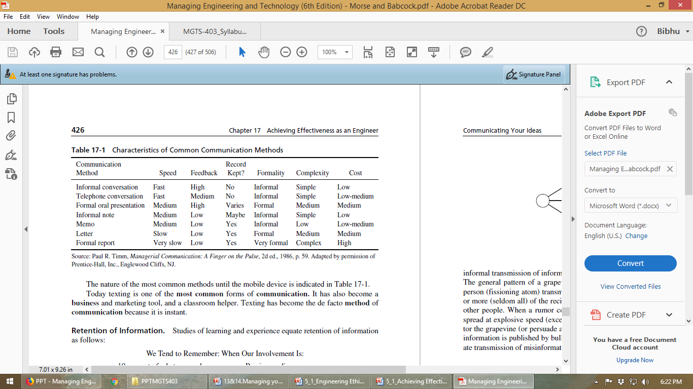

Slide 15
Other factors in effective communication
Active listening
The art of effective listening is as important as effective communication. Listen positively and attentively, allowing the speaker to make his or her point. Analyze the speaker’s attitude and frame of mind.
Non verbal communication
The relative influence of the verbal, vocal, and facial aspects of oral communication:
7 percent: Verbal (words used)
38 percent: Vocal (pitch, stress, tone, length, and frequency of pauses)
55 percent: Facial (expression, eye contact)

Slide 16
Communication Tools of Special Importance to the Engineer
The Written Report
The results of engineering studies are often documented in formal written reports and executive summaries, and the usefulness of the study is determined by whether the report is (1) read and (2) understood.
The Oral Briefing
A briefing is an oral presentation of analyzed and synthesized information.
Effective briefing skills are essential for your success, for the busy executives who will make the final decision on whatever you are proposing often can be approached in no other way (and this may be their principal opportunity to assess your capability for greater responsibility).
Visual Aids
Tools: OHP, PowerPoint, slides Prezi, Flipcharts, etc.

Slide 17
Staying Technically Competent
The Threat of Obsolescence
The Knowledge Explosion
Organizational Obsolescence
Obsolescence
“the process of passing out of use or usefulness”
“the process of being replaced by something newer or better”

Slide 18
Persons are obsolescent technically if, when compared to other members of their profession, they are not familiar with, or are otherwise unfitted to apply the knowledge, methods, and techniques that are generally considered important by the members of their profession.
Organizational Obsolescence
Three areas in which managers can make improvements and thus avoid having an obsolete organization: reward technical contribution, reduce barriers to movement, and focus on careers.

Slide 19
Methods of Reducing Obsolescence
Mastering the Technical Literature
Need to stay knowledgeable about wide range of technology
Professional literatures, research papers
Continuing Education
Formal graduate level university courses
In house course offered by the employer
On-the-job Activity
Personal growth on the job
Challenging work assignment Opportunities provided by the supervisor
Technical Societies Membership
Accreditation, Registration, and Certification

